Slide 1
Measurement of Temperature Using Thermocouple

Slide 2
What is a Thermocouple?
A thermocouple is an electrical device consisting of two dissimilar electrical conductors forming an electrical junction
A thermocouple produces a temperature-dependent voltage as a result of Seebeck effect, and this voltage can be interpreted to measure temperature.
  The Seebeck effect is the electromotive force (emf) that develops across two points of an electrically conducting material when there is a temperature difference between them.
  When an electric current is passed through a circuit of a thermocouple, heat is evolved at one junction and absorbed at the other junction. This is known as the Peltier Effect.
Commercial thermocouples are inexpensive, interchangeable, are supplied with standard connectors, and can measure a wide range of temperatures.
In contrast to most other methods of temperature measurement, thermocouples are self powered and require no external form of excitation.
The main limitation with thermocouples is accuracy; system errors of less than one degree Celsius (°C) can be difficult to achieve.

Slide 3
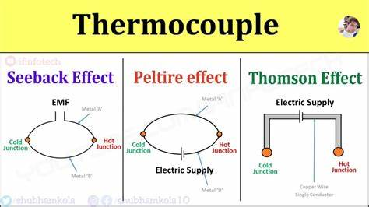

Slide 4
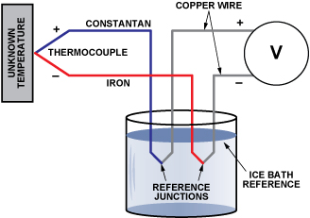
Thermocouple

Slide 5
Material of Wire in Thermocouple
Iron-Constantan.
Cromel-Constantan
Chromal-Alumal
Tunston-Rhedium
Copper-Constantan

Slide 6
Advantages of Thermocouple
Thermocouples are most suitable for Industries
They are rugged and readings are constant.
They can measure over a wide range of temperature.
Their characteristics are almost linear with an accuracy about 0.05%

Slide 7
Disadvantages of Thermocouple
Low sensitivity compared to other temperature measuring devices(eg. RTD, Thermistor)

Slide 8
Thermistor vs Thermocouple
Thermistor
Thermocouple
A more narrow range of sensing (55 to +150ºC – although this varies depending on the brand)
Sensing parameter = Resistance
Nonlinear relationship between the sensing parameter (resistance) and temperature
NTC thermistors have a roughly exponential decrease in resistance with increasing temperature
Good for sensing small changes in temperature (it’s hard to use a thermistor accurately and with high resolution over more than a 50ºC range).
The sensing circuit is simple and doesn’t need amplification & is very simple
Accuracy is usually hard to get better than 1ºC without calibration
Have a wide range of temperature sensing
Can be very accurate
Sensing parameter = voltage generated by junctions at different temperatures
Thermocouple voltage is relatively low
Have a linear relationship between the sensing parameter (voltage) and temperature

